Slide 1
HEAD BRAIN

Slide 2
1. Introduction
The human brain is the maestro in the human body, as it is responsible for organizing all the vital processes in the human body. However, when we deal with the brain medically, we must be very careful because any error, even if it is simple, can be harmful to a large degree, knowing that the brain differs Size and mass throughout a person’s life from childhood to old age, so that we can learn a lot about the brain, we had to collect a lot of information about the brain such as mass and size, and we had to see if this number was identical between many people in the same age group

Slide 3
2. The role of Data science , AI
Data science and artificial intelligence have intervened in this field and have facilitated the matter, as the information that we can obtain has become larger and easy to organize in order to be used. It is possible to obtain millions of information and statistics, which are characterized by high accuracy, which makes relying on them a reassuring thing when we do By teaching the machine, then the machine performs complex mathematical operations that are difficult for a person to solve, and the work of millions of shaking operations leads to the output of a large and more accurate amount of information than before.

Slide 4
3. interest
The great benefit of this matter is that it has become easier and more accurate to obtain statistics and information, and it has become easier for us to organize it and come up with very important information that is able to make a difference in the field of medicine and all other fields, and the matter I am talking about is very important. And the danger in the field of medicine, which is brain surgeries, information and statistics related to the brain, when we wanted to know the average weight and fever of the brain for a specific age group, we needed a large amount of information, so we resorted to data science and artificial intelligence

Slide 5
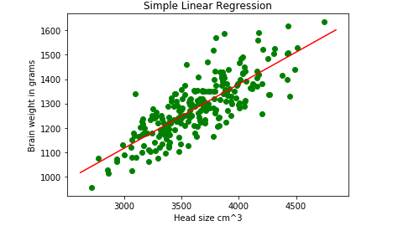
This is relationship between the weight of the brain and its volume, in which the weight is in grams and the volume is in cubic centimeters

Slide 6
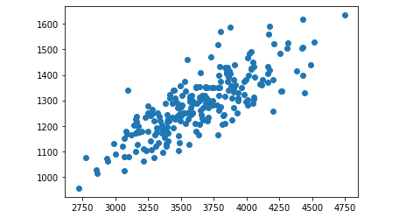
This is a relationship between brain weight and size, and it appears to be a positive relationship

